Slide 1
These materials were created with help from, and for the use of, teachers just like you!
Similar resources can be found here: motheducation.org
Please direct any questions regarding the materials or questions regarding MothEd to this email: news@motheducation.org
This material is adapted by MothEd, from original documents provided by Katelyn O’Brien, for use in classrooms. These materials are copyrighted under a Creative Commons Attribution-NonCommercial-ShareAlike 4.0 International License. Attribution should be given to MothEd and Katelyn O’Brien.
This material is created with support by the National Science Foundation under Grant No. 2100990. Any opinions, findings, and conclusions or recommendations expressed in this material are those of the author(s) and do not necessarily reflect the views of the National Science Foundation.

Slide 2
This slideshow serves as a brief guide to trapping; covering step-by-step instructions on building a trap, along with guidance on when and where to place it.
This is a flexible resource designed to be customized and tailored to your classroom needs. Feel free to remove this slide and modify the presentation as you see fit.
Happy trapping!

Slide 3
Trapping Guide
HOW to trap,
WHERE to trap,
And more!

Slide 4
How to Build A Bottle Trap
Materials and Steps

Slide 5
Construction Materials
2 clear two-liter pop bottles (makes 1 trap)
UV Lights
String or yarn (~4 feet per trap)
Scissors
Bread twist-ties
Binder clips (1 per trap)
Pesticide strip
Clear tape
Heavy duty handheld hole punch
Permanent marker

Slide 6
Use These Bottles:
Avoid These Bottles:

Slide 7
Remember:
The trap is easier to construct when the bottles are the same brand and size
It is best to use bottles with a long flat side than the textured bottles (see above)
The bottles must be clear (green plastic will filter the color of light in the trap)

Slide 8
Let’s start constructing!

Slide 9
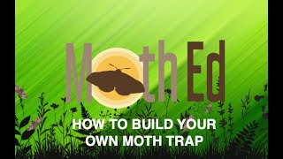

Slide 10
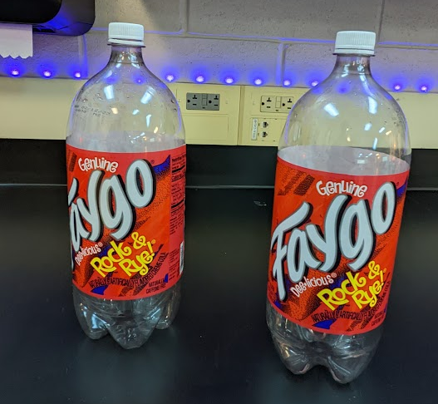

Slide 11
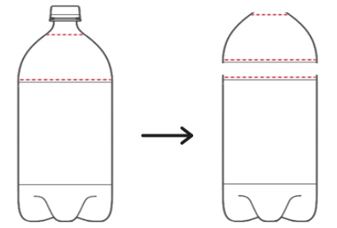
Cutting the Bottles
STEP 1:
On the first bottle, cut along the neck of the bottle and above the label (on the red lines)
The top curved piece will become the funnel
The bottom portion will become the collection bucket

Slide 12
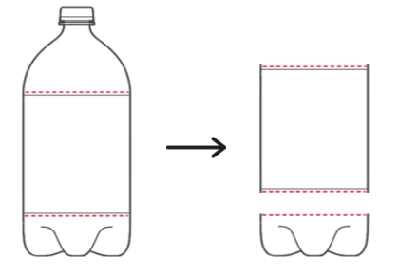
STEP 2:
On the second bottle, cut along both ends of the label area
The middle of the bottle will become the panels
The bottom of the bottle will become the lid

Slide 13
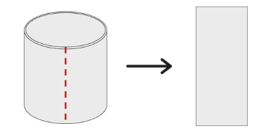
Constructing the Panels
STEP 3:
Taking the middle of the second bottle, cut across the piece to open the bottle up.

Slide 14
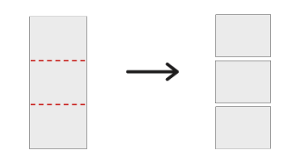
STEP 4:
Cut the panel of plastic into 3 pieces of the same size

Slide 15
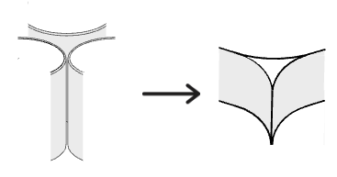
STEP 5:
Line up the 3 pieces of plastic in a triangle-like shape and tape the sides to keep the panels together

Slide 16
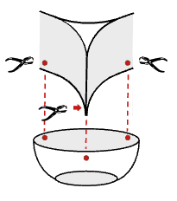
Attaching the Funnel
STEP 6:
Using the hole puncher, punch a hole in each bottom corner of the panes AND three evenly spaced holes at the top of the curved piece from the first bottle.

Slide 17
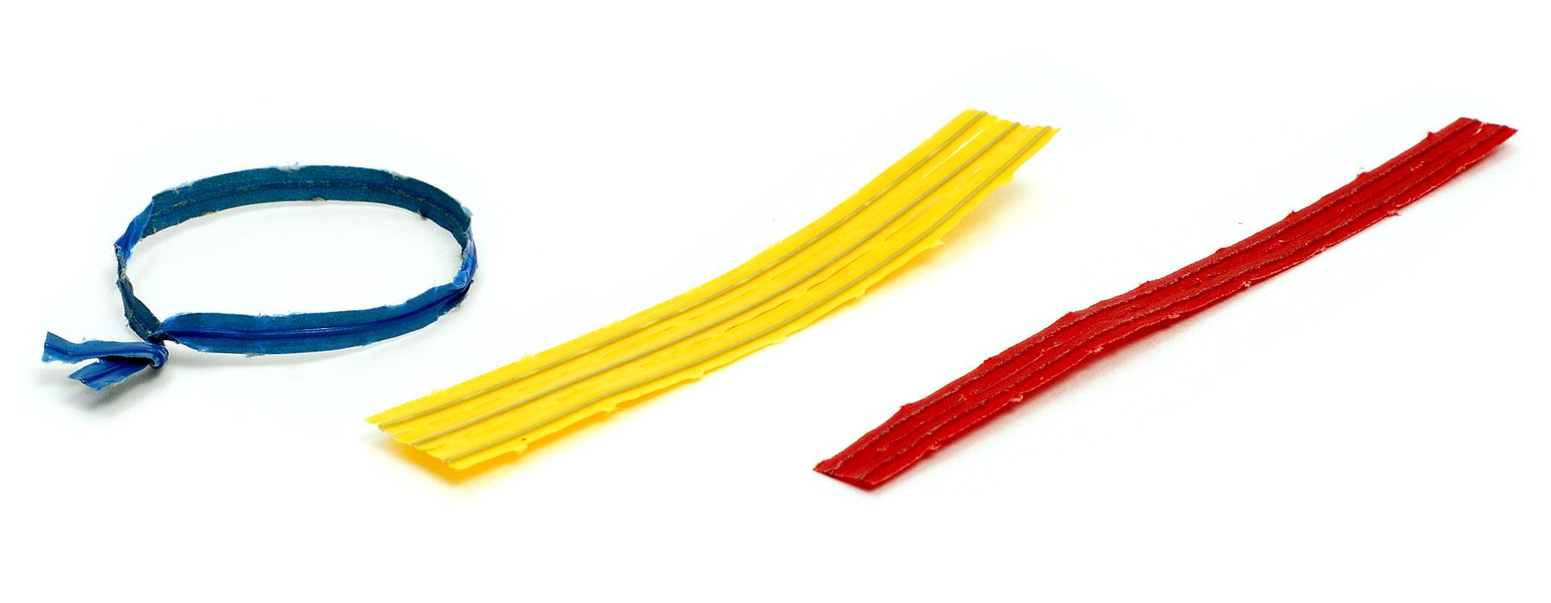
STEP 7:
Use twist ties to connect the three corners of the panels (on top) to the funnel (on bottom).
You should only need 3 twist ties for this.

Slide 18
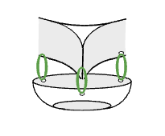
STEP 7:
The panes should be firmly attached to the funnel

Slide 19
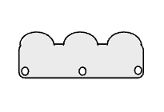
Attaching the Lid
STEP 8:
Punch three evenly spaced holes in the bottom piece from the second bottle.

Slide 20
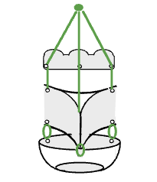
STEP 9:
Attach the lid to the top of the panes by threading the strings through the holes in both the lid and the panes.

Slide 21
Attaching the Lights
STEP 10:
Attach the LED Keychain light to a pane, pointed inwards, using clear packing tape.

Slide 22
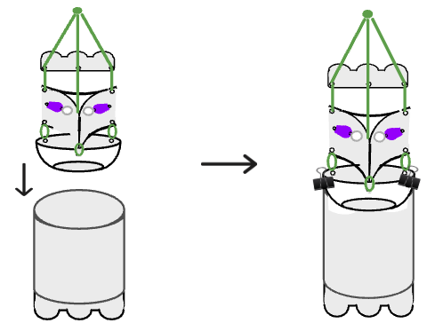
Final Assembly
STEP 11:
Attach the funnel piece to the collection bucket using binder clips
Don’t forget to place pesticide strips in the bucket when trapping!

Slide 23
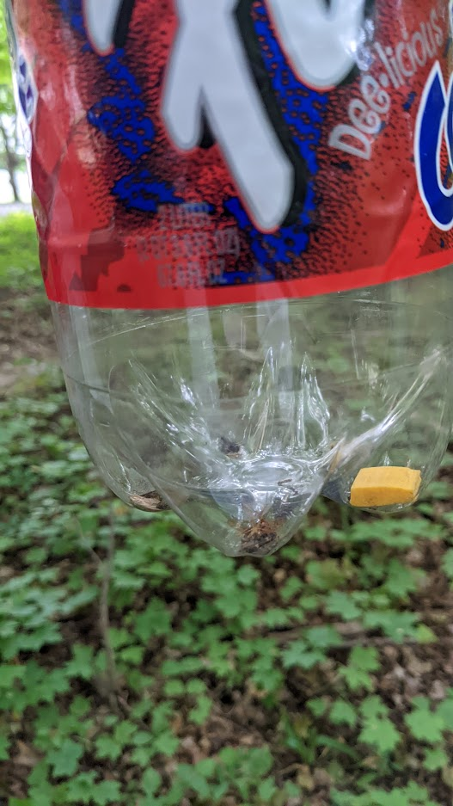
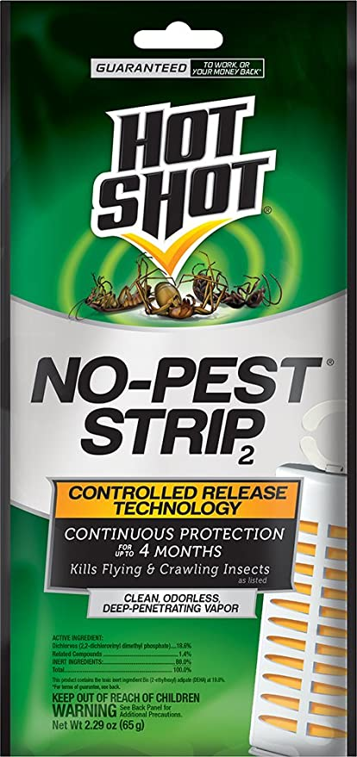
Pesticide Strip Safety
Pesticides are harmful chemicals!
Eating or touching the pesticide strips will result in sickness!
Scientists don’t eat chemicals! 😋
Pesticide strips were already placed in traps at school and should stay there.

Slide 24
When to trap?
What variables make for a good trap night?

Slide 25
Time of Day
Night Time - about 30 minutes before sundown
Moths are most active around dusk

Slide 26
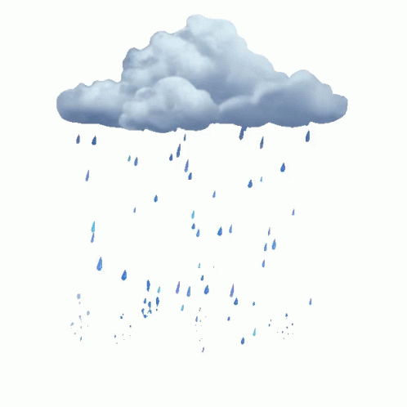
Weather Conditions
Moths do not like wind or rain
Moths like heat and humidity
Above 55°F
Please note that while these are ideal conditions, traps can still be successful in less than ideal circumstances

Slide 27
Where to trap?
What location factors affect traps?

Slide 28
Location
Place traps near vegetation, and away from distracting lights (like a porch light)!
Moths fly at about 5ft, place traps accordingly!

Slide 29
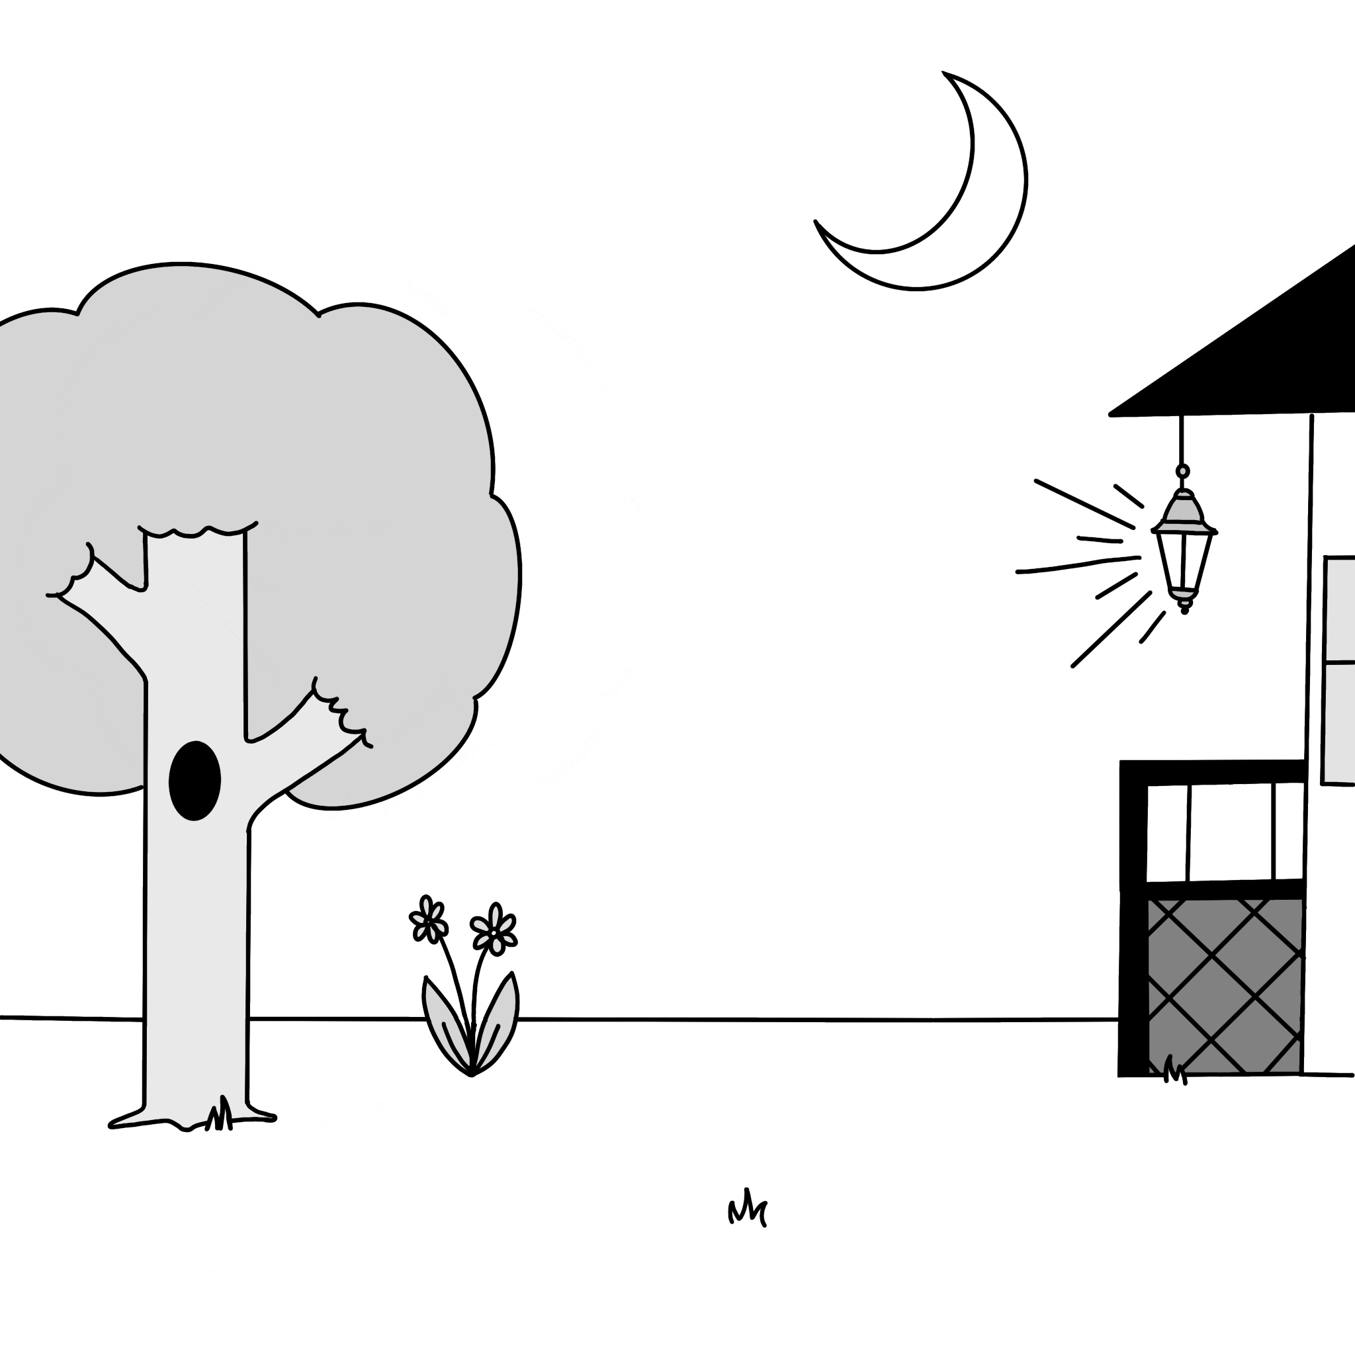
Where would you place your trap?
Notes:
Note to Teachers: This image is intended as a way to facilitate conversations with, and between, students on when and where to place traps. This image could also serve as a way to plan trap placement graphically.

